Slide 1
WELCOME

Slide 2
CHATLINK

Slide 3
TEAM MEMBERS
NAVEENKUMAR K (927621BIT075)
SANJAI KUMAR S (927621BIT097)
SHANKAR S (927621BIT102)
THENDRALARSAN K (927621BIT117)
Guided By
Mr.S.SATHIYANATHAN (AP/IT)

Slide 4
ABSTRACT
Chatting website is a feature or a program on the Internet to communicate directly among Internet users who are online or who were equally using the internet. Chatting website allow users to communicate even though from a great distance.

Slide 5
PROBLEM STATEMENT
Create a web chat app for smooth real-time conversations, tackling scalability, security, and multilingual hurdles. Incorporate user feedback and tech innovations to enhance the experience.

Slide 6
OBJECTIVE
A user-friendly chat app that facilitates seamless and secure communication among individuals and groups.
Enhance engagement through interactive features like emojis, stickers, and voice messages.
Provide customization options, including themes and notification settings.
Offer cross-platform compatibility for a consistent experience across devices.
Allow users to send messages even when offline, with messages being delivered once they regain connectivity.

Slide 7
Literature SURVEY
Serial No | Authors | Title | Description
1 | Noor Sabah , Jamal M.Kadhim, Ban N.Dhannoon | Developing an End-to-End Secure Chat Application | A list of requirements to make secure chat application is presented in this paper and based on these requirements, the application was designed
2 | A. A. Shirode, Mohit Dhande , Awantika Jadhav | A Webchat Messenger | The main contribution of this paper is a state-of-the-art chat application having completely been designed with built security measures.
3 | Dr. Abhay Kasetwar, Ritik Gajbhiye, Gopal Papewar | Development of Chat Application | It is designed to communicate or chat with others online. It is more reliable and secure.

Slide 8
Literature SURVEY
Serial No | Authors | Title | Description
4 | Ashutosh Kumar | Group chatting Application | This paper shows the importance of chat application in day today life and its impact in technological world.
5 | Chandrashekhar, U. A. Jogalekar | A Study of Web Chat Applications with Performance Measurment Parameters | This is used to send instant messages to agents requesting for help.
6 | Jhalak Mittal, Arushi Garg, Shivani Sharma. | Online Chat Request | This research paper contains the information we have provided to maintain the security and protection of the request for a speech.

Slide 9
Literature SURVEY
Serial No | Authors | Title | Description
7 | R. Gayathri, C. Kalieswari | Multi-User Chat Application | This research paper contains that the chat app provides a better and more flexible program for discussion.
8 | Diotra Henriyan, Pratama Subiyanti, Rizki Fauzian | Designing and deploying a real-time web-based chat server | This research paper contains that chat app should be a real-time forum and multi-site for use by many users.
9 | Rahul Khandelwal, Dishant Solanki, Teena Verma | Design &Implementation Of Real Time Chat Application | The chat application allows to send the same message to many users at a same time without any problem.

Slide 10
Literature SURVEY
Serial No | Authors | Title | Description
10 | Jhalak Mittal, Arushi Garg, Shivani Sharma | Online Chatting Application | The online communication application must be capable off the writings or pictures or some other documents in a quicker manner with least deferral or with no postponement.
11 | Akshata Vhandale, Sayam N Gandhak, Saundarya Karhale | An Overview Of Real-time Chat Application | This chat application in the manufacture begins with the collection of relevant data that will be displayed in the web and mobile versions.
12 | Satish Singh, Satyam Singh, Dr. Ashish Sharma | Real-Time Web-Based Secure Chat Application | The purpose of this project is to develop a web application that will allow users to instantaneously and at the moment connect.

Slide 11
EXISTING SYSTEM
Most of the web pages doesn’t provide the customization in the visual mode.
Latency issues.
Some web page doesn’t provide end-to-end encryption.

Slide 12
PROPOSED SYSTEM
Provide the secured and seamless connection among the people.
Provide easy way to connect multiple people at a time .
Provide the full duplex as the multiple user can share their thought’s at the same time
Provide the features like customization in the theme.

Slide 13
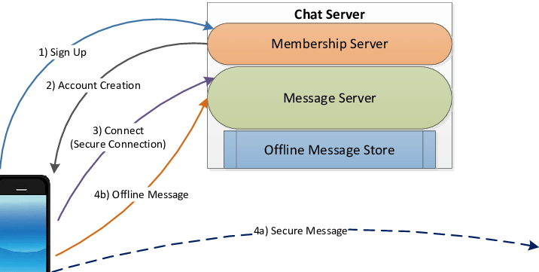




SYSTEM ARCHTECTURE DIAGRAM

Slide 14
MODULES
Home Module
Register Module
Login Module
Messaging Module

Slide 15
Module description
HOME MODULE
Home module displays the greeting message and has the options to access the next modules.
REGISTER MODULE
Register module allows the users to create a account by entering the basic details.

Slide 16
Module description
LOGIN MODULE
Login module allows the users to access the chatting page by entering the username and password.
MESSAGING MODULE
Messaging module is the important module which allows the users to chat with each other.

Slide 17
REFERENCE
https://www.irjmets.com/uploadedfiles/paper//issue_5_may_2022/23435/final/fin_irjmets1652985567.pdf
https://www.researchgate.net/publication/360483603_Research_paper_on_Group_chatting_Application
https://portal.bazeuniversity.edu.ng/student/assets/thesis/20210215120658149063642.pdf
https://gscen.shikshamandal.org/wp-content/uploads/2022/sp/BCCA20-21/22.pdf
https://www.academia.edu/81380770/Development_of_Chat_Application
https://www.academia.edu/10596971/A_STUDY_OF_WEB_CHAT_APPLICATIONS_WITH_ITS_PERFORMANCE_MEASURMENT_PARAMETERS

Slide 18
OUTCOME
A chatting website offers real-time communication through text. Users can connect with others globally, fostering social interactions, networking, and collaboration. It provides a platform for sharing information, ideas, and experiences.

Slide 19
THANK YOU

